Slide 1
CHEMICAL COMPATIBILITY AND HIGH-TEMPERATURE LIMITS FOR STRUCTURAL MATERIALS
Nasr M. Ghoniem
Mechanical and Aerospace Engineering Department
University of California at Los Angles (UCLA)
Los Angeles, CA. 90095-1597
APEX Study Meeting
SANDIA NATIONAL LABS
Albuquerque, N.M.
July 27-28, 1998

Slide 2
COOLANT - STRUCTURAL MATERIAL SYSTEMS
COOLANT
STRUCTURAL MATERIAL
Liquid Lithium
Liquid Lithium-Lead
Molten Salts (FLiBe)
Helium
Vanadium Alloys
Silicon Carbide Composites
Ferritic Steels
Refractory Alloys (Ta, Nb, Mo, W)

Slide 3
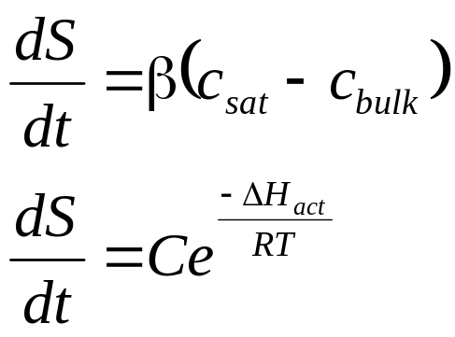
LIQUID METAL CHEMICAL COMPATIBILITY
(Basic Mechanisms)
Dissolution in Liquid Metal
 = mass transfer coefficient
c_{sat} = element saturation concentration in liquid metal
c_{bulk} = actual element concentration in bulk
H_{act} = activation energy for dissolution

Slide 4
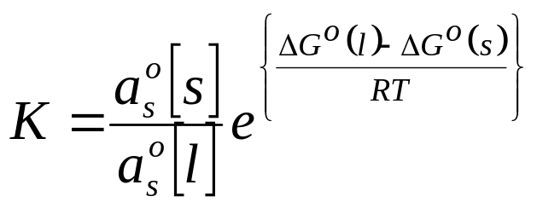
LIQUID METAL CHEMICAL COMPATIBILITY
(Basic Mechanisms) cont.
Exchange due to non-metallic Elements
For oxygen, carbon, and nitrogen, the distribution coefficient is:
a_{s}º are saturation activities for solid (s) and liquid (l).
For K>1, we get pick-up.
For K<1, we get loss.

Slide 5
COMPATIBILITY OF VANADIUM ALLOYS WITH LIQUID LITHIUM
For V-3Ti-1Si and V-15Cr-5Ti at 550ºC in flowing lithium (Borgstedt):
  weight loss: 10⁻³ - 3x10⁻³ g/m²hr
  weight loss is strongly influenced by nitrogen content of the liquid metal.
  Reaction is parabolic with an activation energy of 180kJ/mol (≈ nitrogen diffusion energy in vanadium)

Slide 6
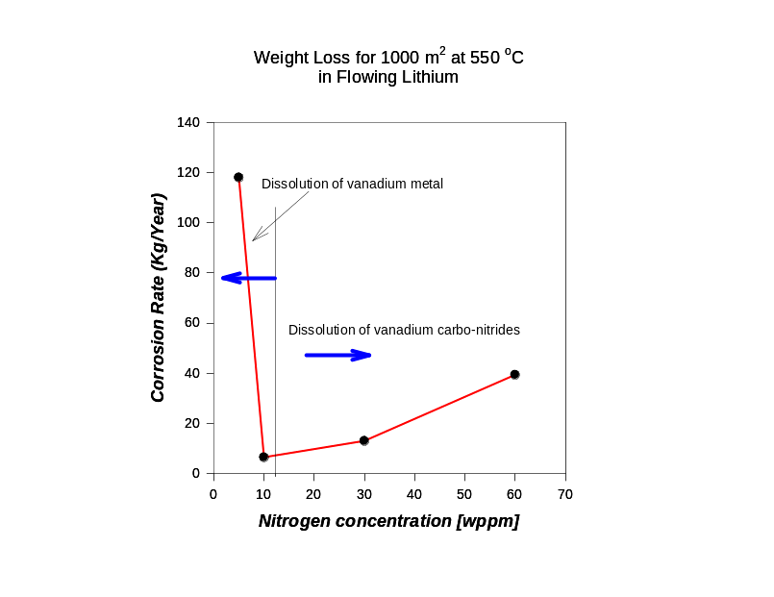
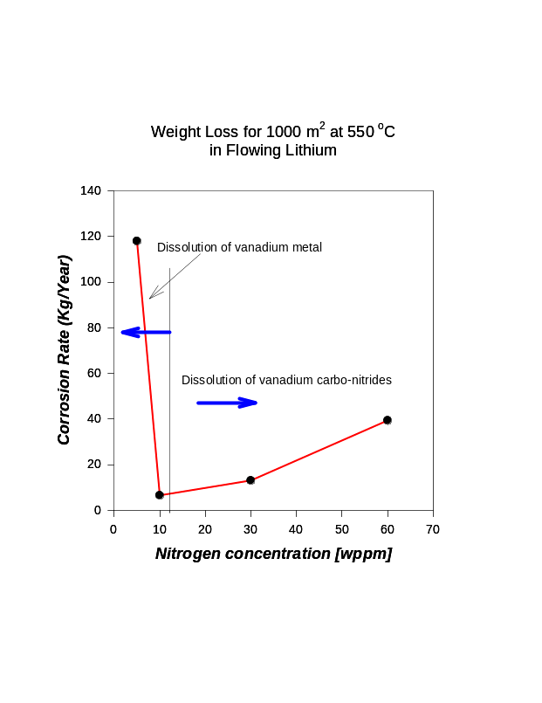
CALCULATED WEIGHT LOSS IN 1000 m² SYSTEM

Slide 7
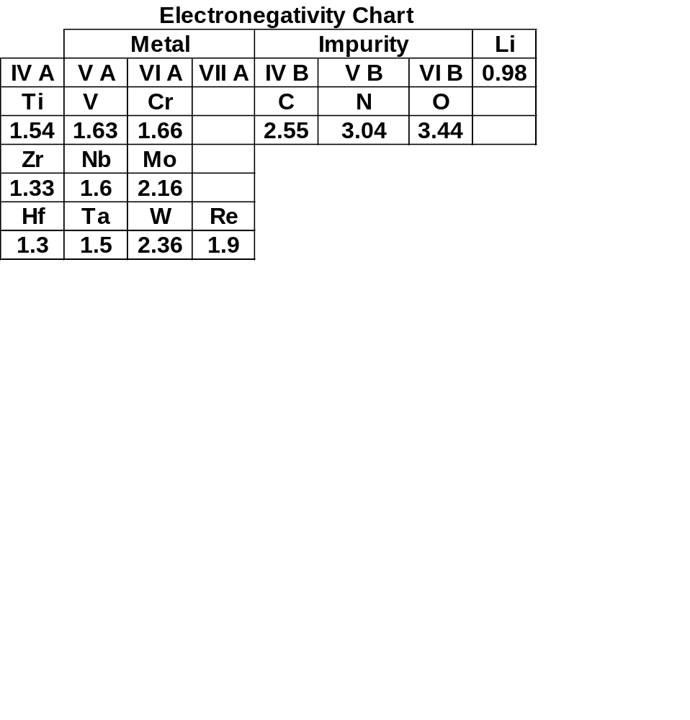
MAIN CORROSION MECHANISM FOR REFRACTORY METALS
Damaged brittle layer
Lithium
Li_{x}M_{y}I_{z}
M = refractory metal
I = interstitial impurity

Slide 8
EQUALIZATION OF ELECTRONEGATIVITY
Electronegativity ≡ the relative ability to acquire a negative charge.
Metal
Impurity
(highly electro-negative)
(low in electronegativity)
Impurity
Metal
(gets larger by acquiring more than 1/2 the valence electrons)
(gets smaller with losing more than 1/2 the valence electrons)

Slide 9
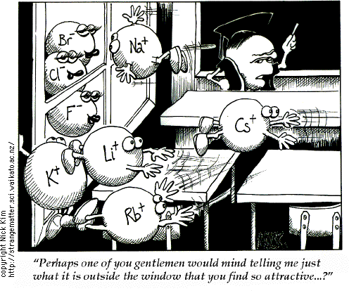
CONCEPT OF ELECTRONEGATIVITY

Slide 10
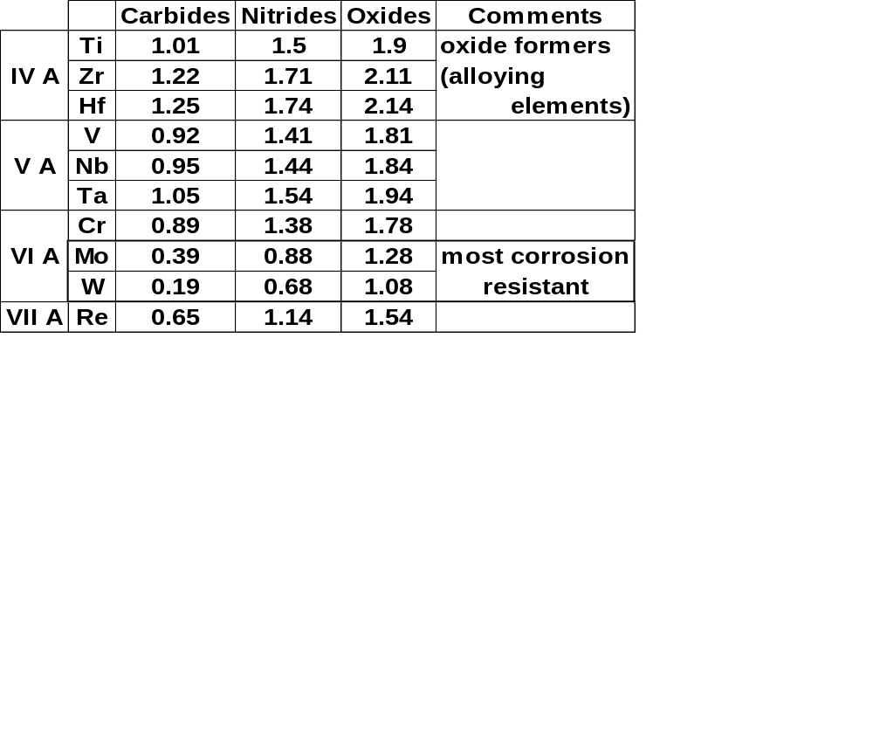
COMPOUND STABILITY BASED ON ELECTRONEGATIVITY

Slide 11
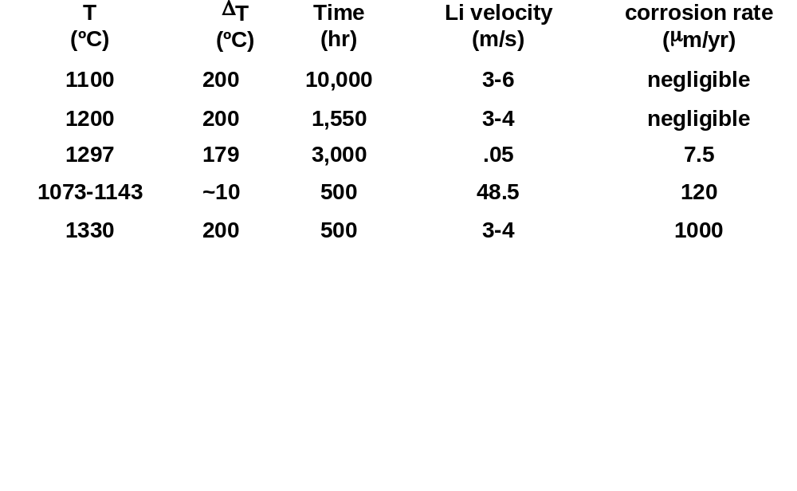
EXPERIMENTAL OBSERVATIONS OF LITHIUM COMPATIBILITY WITH REFRACTORY METALS
Up to lithium velocities of 6m/s, the temperature limit for acceptable corrosion for Nb alloys is ~1250ºC, while that for Ta alloys is ~1350ºC.*
Corrosion Rates for Nb-1Zr
*References:
1. A.J. OVERMAN, et al, LCRE Non Nuclear System Test, Final Report PWAC-402, Part IV, Pratt and Whitney Aircraft, Middletown, Connecticut (October 1965).
2. L.G. HAYES, Corrosion of Niobium-1Zr Alloy by Lithium at High Velocities, JPL Technical Report 32-1233 (December 1, 1967).
3. M.S. FREED, Corrosion of Columbian Base and Other Structural Alloys in High Temperature Li, PWCA-3555 (June 30, 1961).

Slide 12
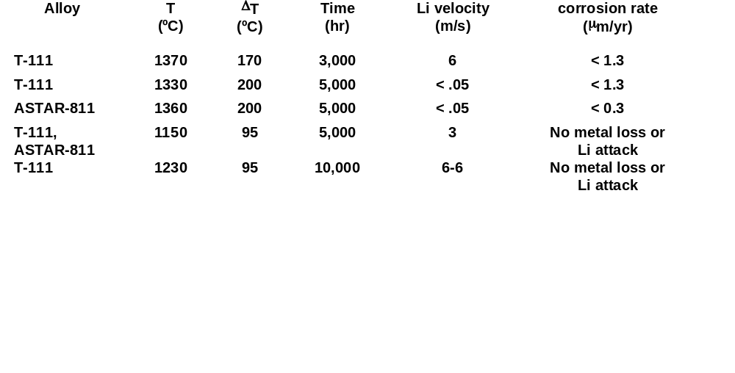
EXPERIMENTAL OBSERVATIONS OF LITHIUM COMPATIBILITY W/ REFRACTORY METALS (cont.)
Corrosion Rates of Tantalum Alloys in Flowing Lithium
*References cont.:
4. J.E. DEVAN and C.E. SESSIONS, Nucl. App. Tech 3, 102-109 (February 1967).
5. J.E. DEVAN and C.E. SESSIONS, Nucl. App. Tech 9, 250-259 (August 1967).
6. G.W. AUSTON, Lithium Corrosion Investigation of Columbiam-Zironicum Alloy System PWAC-343 (June 27, 1961).

Slide 13
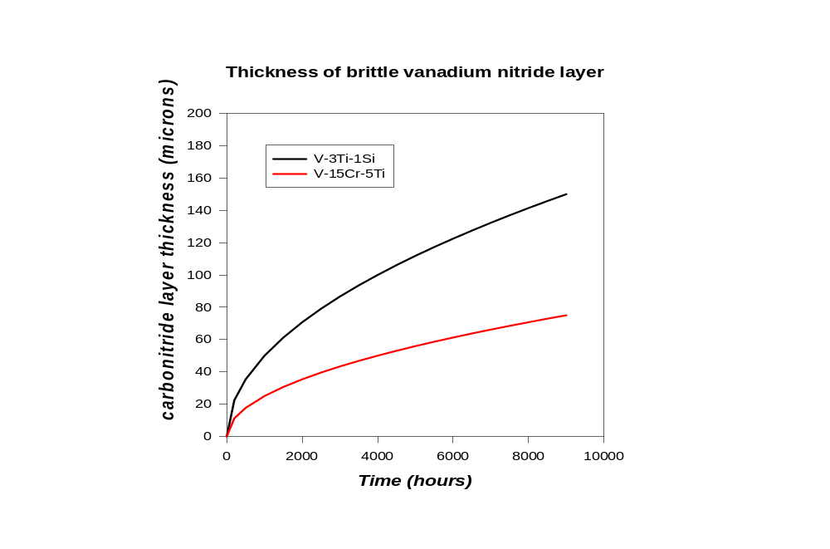
CALCULATED EVOLUTION OF CARBONITRIDE LAYER ON VANADIUM

Slide 14
INTERSTITIAL TRANSPORT IN REFRACTORY METAL-LITHIUM SYSTEM
Oxygen: Will be transported from all refractories to lithium (except for yltrium, hafnium, and zirconium)
Carbon: All metals (except for Mo and W) will be a sink for carbon.
Nitrogen: All metals (except for Mo and W) will getter nitrogen.

Slide 15
COMPATIBILITY OF SiC/SiC COMPOSITES WITH COOLANTS
Corrosion Reactions:
SiC(s) + O₂(g) = SiO(g) + CO(g): Low Po₂
SiC(s) + 3/2O₂(g) = SiO₂(s) + CO(g): High Po₂
SiC(s) + 2H₂(g) = Si + CH₄(g)
SiC(s) + 2H_{z}O(g) = SiO(g) + CO(g) + 2H₂(g)
SiO₂(s) + H₂(g) = SiO(g) +H₂O(g)
M₂O(l) + SiO₂(s) = M₂SiO₃(s)
xSiO₂(s) + Na₂SO₄(l) = Na₂O • x(SiO₂) (l) + SO₃(g)

Slide 16
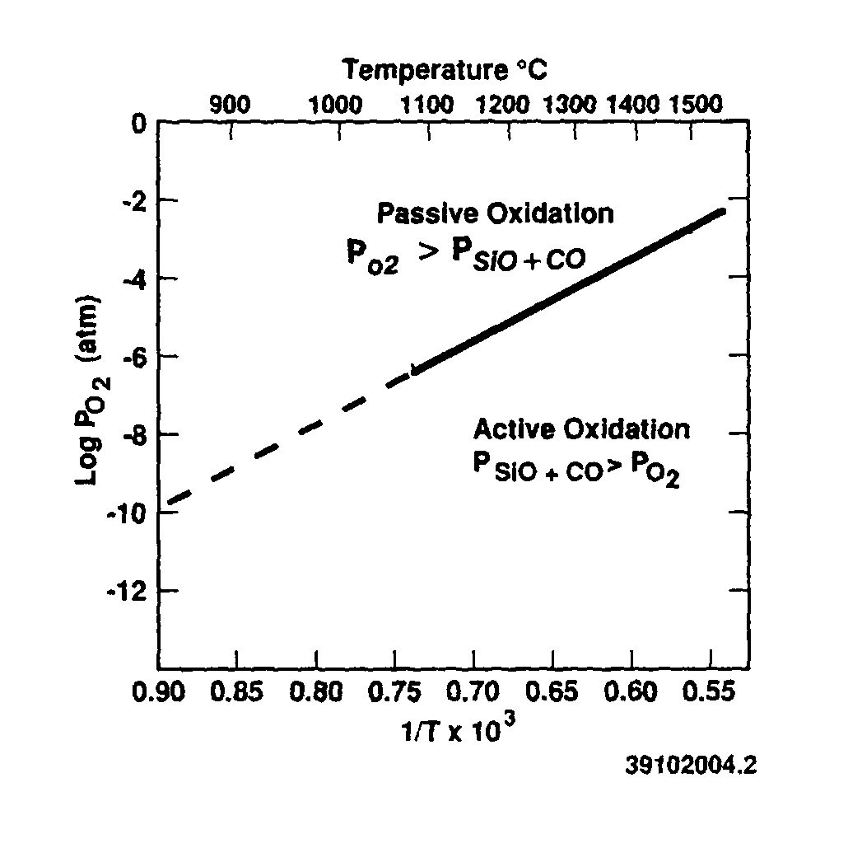
COMPATIBILITY OF SiC/SiC COMPOSITES WITH COOLANTS (cont.)

Slide 17
COMPATIBILITY OF SiC/SiC COMPOSITES WITH COOLANTS (cont.)
Experimental Observations
For α-SiC exposed to a thin layer of Li (30-60min, T < 500ºC), RT fracture strength decreased from 350MPa to 150MPa, and fracture toughness from 4MPa•m^{1/2} to 2MPa•m^{1/2}.
Intergranular penetration and crack growth is a result of reduction of the protective SiO₂ glassy phase.
Flowing Lithium will accelerate corrosion.
SiC/SiC may not be compatible with lithium.

Slide 18
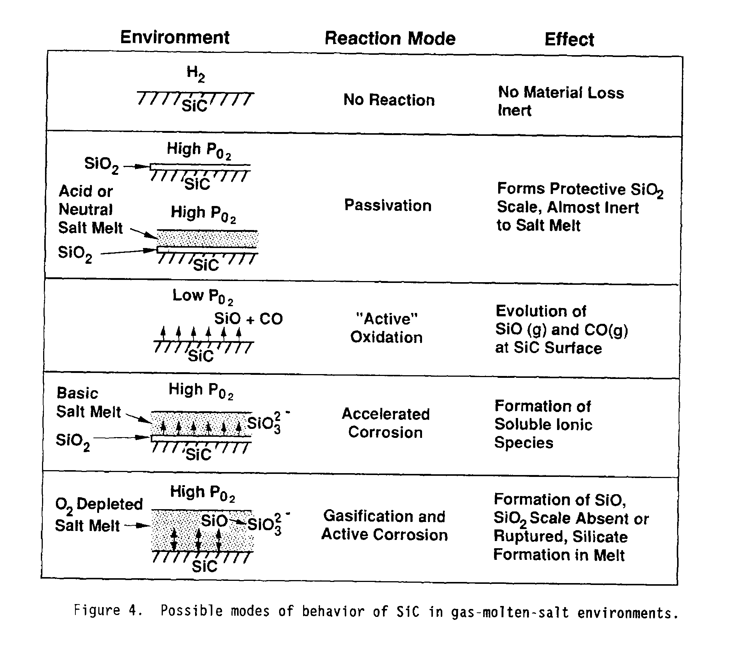
COMPATIBILITY OF SiC/SiC COMPOSITES WITH COOLANTS (cont.)
Molten Salt Effects on SiC/SiC

Slide 19
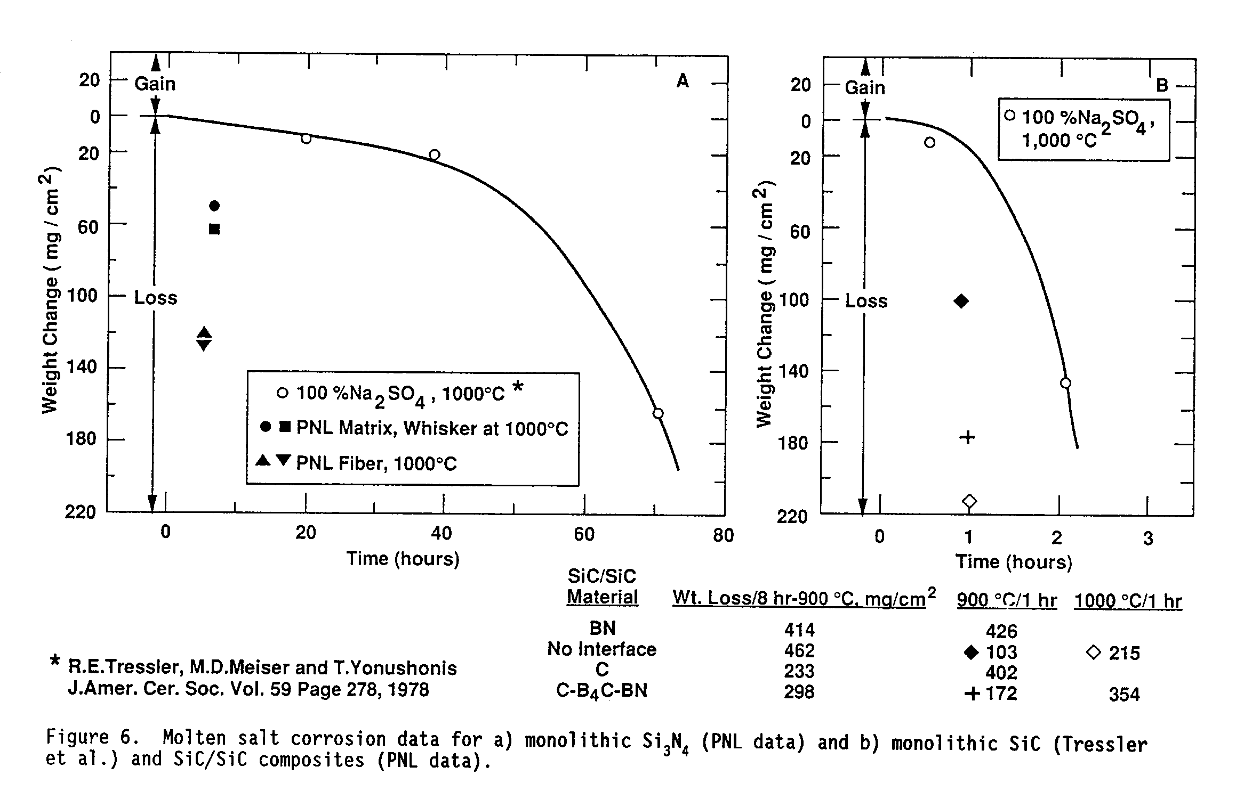
COMPATIBILITY OF SiC/SiC COMPOSITES WITH COOLANTS (cont.)
Molten Salt Effects on SiC/SiC (cont.)

Slide 20
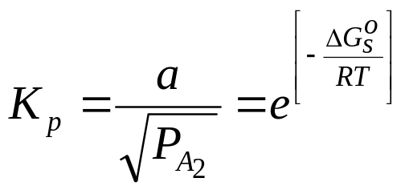
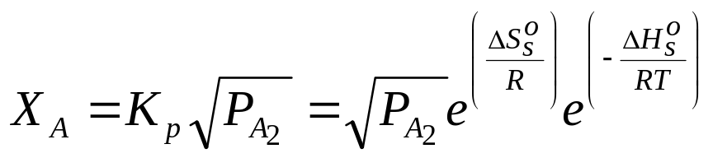
COMPATIBILITY OF REFRACTORY METALS WITH NON-METALLIC IMPURITIES
1. Hydrogen and Nitrogen Reactions
A₂(g) ⇔ 2A(in M)
Equilibrium ⇒
K_{p} = equilibrium constant, a = activity.
For dilute solutions ⇒ Sievert’s Law:

Slide 21
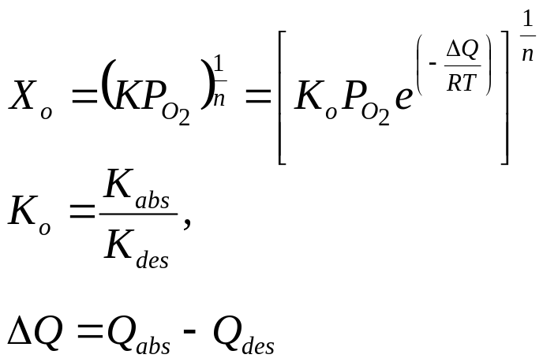
COMPATIBILITY OF REFRACTORY METALS WITH NON-METALLIC IMPURITIES (cont.)
2. Oxygen
O₂(g) → 2O(in M) [absorption]
nO(in M) + M(s) → MO_{n}(g) [desorption]

Slide 22
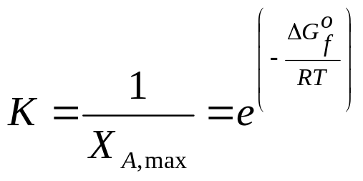
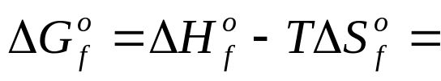
COMPATIBILITY OF REFRACTORY METALS WITH NON-METALLIC IMPURITIES (cont.)
3. Compound Formation
Gas/metal: 1/2A₂(g) + (m/n)*M(s) ⇔ (1/n)*M_{m}A_{n}(s)
Saturated solution: A(in M) + (m/n)*M(s) ⇔ (1/n)*M_{m}A_{n}(s)
X_{A.max} = maximum solid solubility
Formation energy

Slide 23
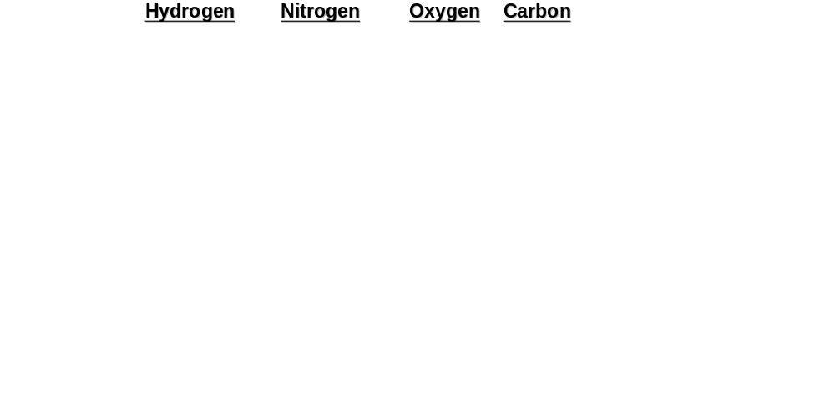
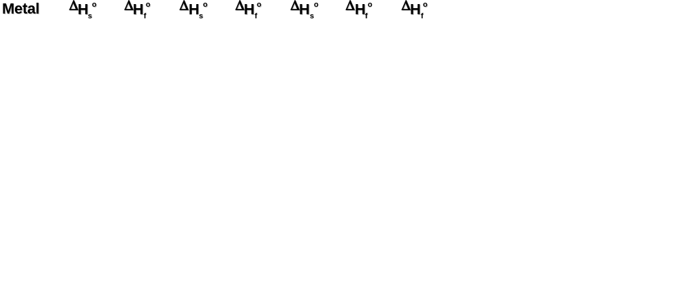
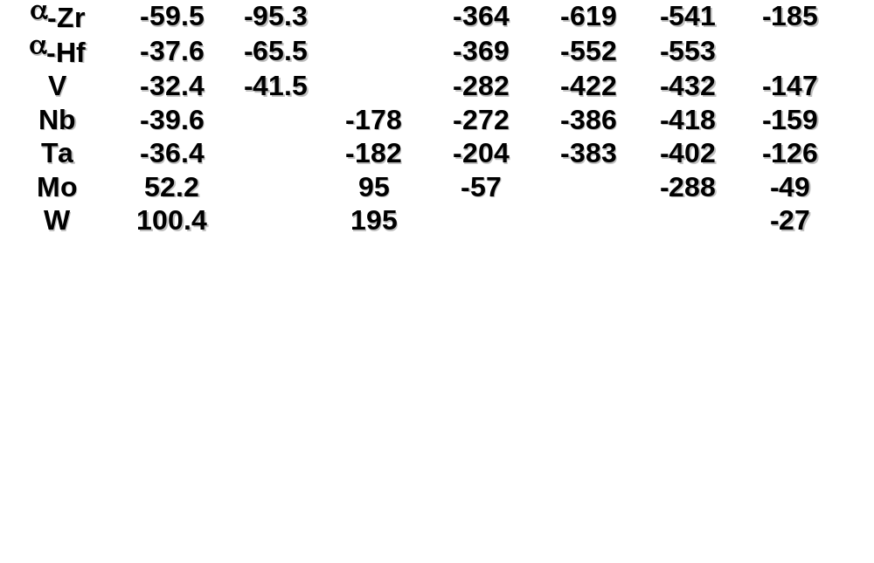
COMPATIBILITY OF REFRACTORY METALS WITH NON-METALLIC IMPURITIES (cont.)
ΔH_{s}º and ΔH_{s}º Values in kJ/(g•atom) for Solution of H, N, and O in Solid Refractory Metals or Formation of the Corresponding Metal-Rich Compounds with H, N, O and C.*
*References:
7. E. Fromm and E. Gebhardt, eds., Gase und Kohlenstoff in Metallen, (Berlin, Springer, 1976)
8. H. Jehn, H. Speck, E. Fromm, W. Hehn and G. Hörz, “Gases and Carbon in Metals (Thermodynamics, Kinetics and Properties),” Physics Data, Series 5, Fachinformationszentrum Energie, Physik, Mathematik, Karlsruhe; “Pt. V, GroupIVa Metals (1), Titanium” [no.5-5 (1979), 78 pp.]; “Pt.VI, Group Iva Metals(2), Zirconium, Hafnium” [no5-6 (1979), 74pp.]; “Pt. VII, Grouop Va Metals(1), Vanadium” [no.5-7 (1981), 64pp.]; “Pt. VIII, Group Va Metals(2), Niobium” [no. 5-8 (1981), 117pp.]; “Pt. IX, Group Va Metals(3), Tantalum” [no. 5-9 (1981), 74pp.]; “Pt. X, Group Via Metals(1), Chromium, Tungsten” [no. 5-10(1980), 60pp.]; “Pt. XI, Group Via Metals(2) Molybdenum” [no. 5-11(1980) 51pp.]; and “Pt. XII, Group VIIa Metals, Manganese, Technettium, Rhenium” [no. 5-12(1981), 27pp.].
9. E. Fromm and G. Hörz, “Hydrogen, Nitrogen, Oxygen, and Carbon in Metals,” Intern. Met. Rev., Nos. 5 and 6, (1980), pp.269-311.

Slide 24
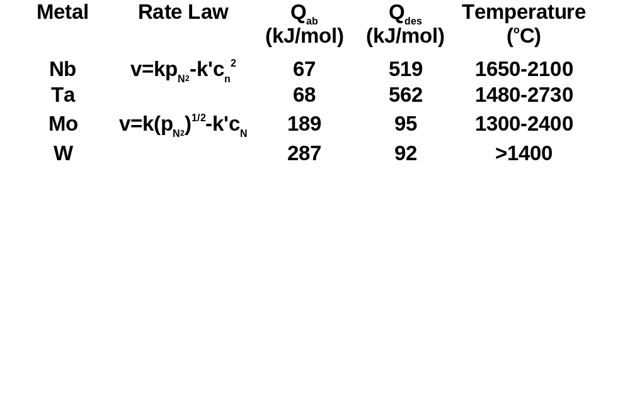
COMPATIBILITY OF REFRACTORY METALS WITH NON-METALLIC IMPURITIES (cont.)
Rate laws and Activation Energies of Nitrogen Absorption and Desorption for Nb, Ta, Mo and W.*
*References:
10. G. Hörz, “Niob,” in Ref. 7, pp.460-494.
11. G. Hörz, “Tantal,” in Ref. 7, pp. 494-520.
12. H. Jehn, “Molybdän,” in Ref. 7, pp. 534-551.
13. H. Jehn, “Wolfram,” in Ref. 7, pp. 552-563.

Slide 25
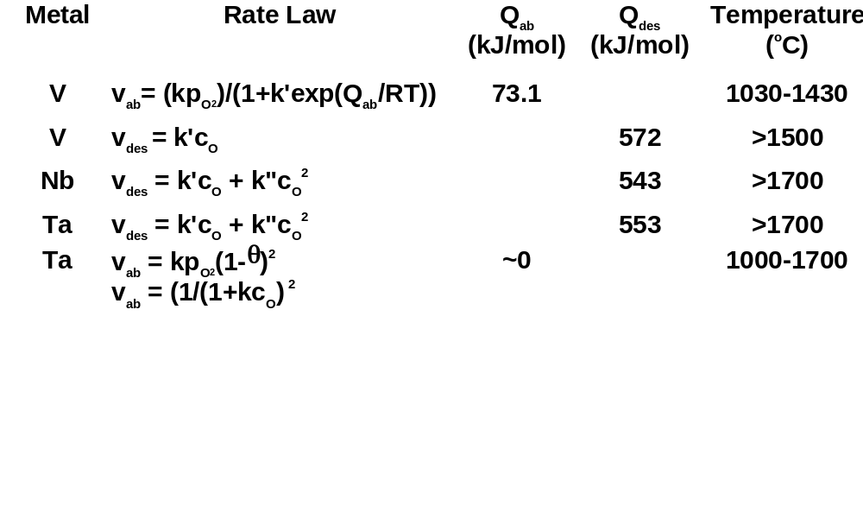
COMPATIBILITY OF REFRACTORY METALS WITH NON-METALLIC IMPURITIES (cont.)
Rate laws and Activation Energies of Nitrogen Absorption or Desorption of Oxygen.*
*References:
14. G. Hörz, “Vanadium,” in Ref. 7, pp.441-460.
15. G. Hörz, H. Kanbach, R. Klaiss and H. Vetter, “Influence of the Surface State on the Reactions of Transition Metals with Nitrogen, Oxygen and Hydrocarbons,” Proc. 7th Intern. Vac. Congress and 3rd Intern. Conf. On Solid Surf., Vienna, (1977), pp. 999-1002.

Slide 26
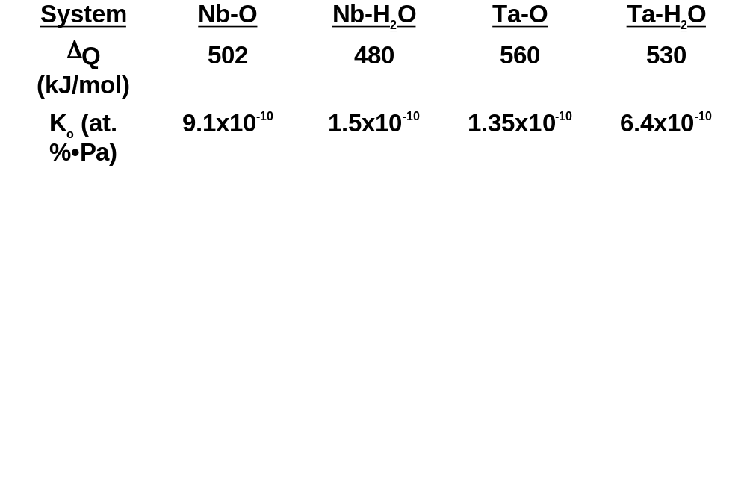
COMPATIBILITY OF REFRACTORY METALS WITH NON-METALLIC IMPURITIES (cont.)
Values of ΔQ and K_{o} Determining the Steady-State Relations for the Reaction Systems of Nb and Ta with O₂ and H₂O.*
*References:
16. G. Hörz, “Kinetik und Mechanismen,” in Ref. 7, pp.1-83.
17. H. Jehn, “Vorgänge beim Glühen der Via- und Va- Metalle in Sauerstoff, Luft und Wasserdampf bei niedrigen Drücken,” Metall, 28 (1974), pp. 699-705.
18. K. Schulze and H. Jehn, “Behaviour of Niobium and Tantalum at High Temperatures in Low-Pressure Oxygen-Containing Atmospheres,” Proc. 8th Intern. Vacuum Congress, Cannes, France (1980), Vol. II, pp. 554-557.

Slide 27
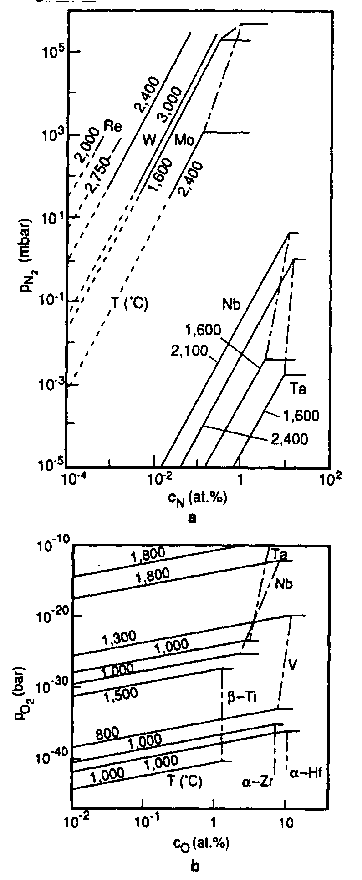
COMPATIBILITY OF REFRACTORY METALS WITH NON-METALLIC IMPURITIES (cont.)

Slide 28
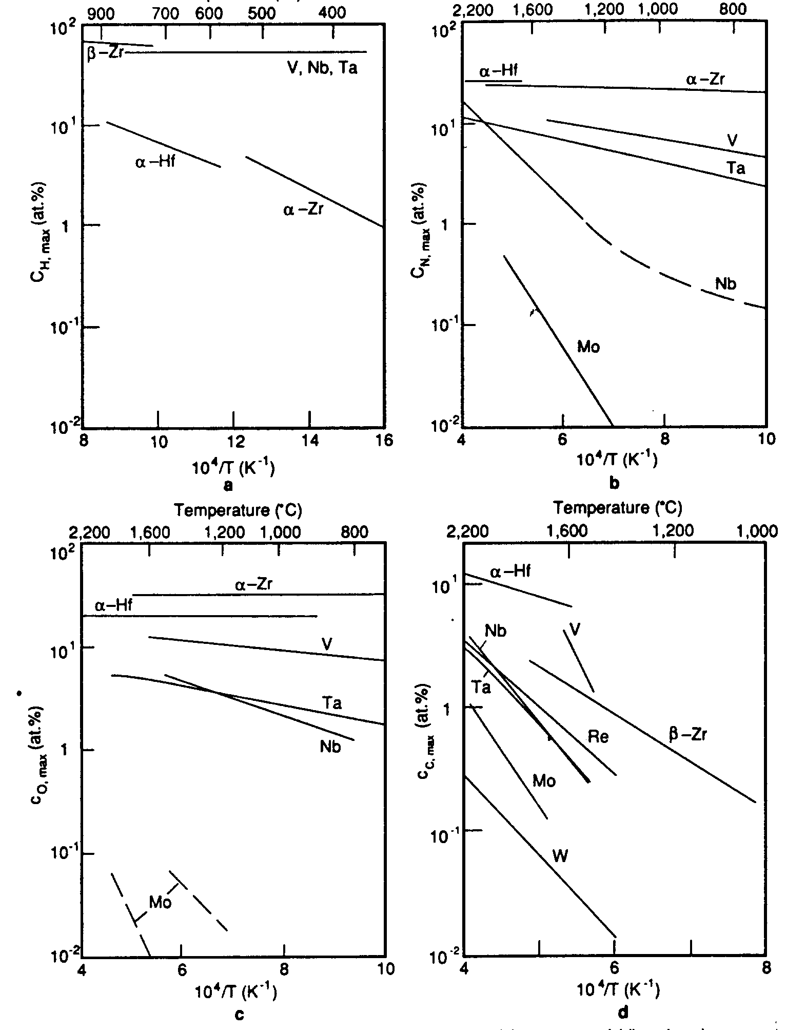
COMPATIBILITY OF REFRACTORY METALS WITH NON-METALLIC IMPURITIES (cont.)

Slide 29
COMPATIBILITY OF REFRACTORY METALS WITH NON-METALLIC IMPURITIES (cont.)
Experimental Observations and Conclusions
Nb and Ta show high nitrogen solubilities (between 0.1 and 10 at %) at low pressures (10⁻⁴-10⁻³bar).
Nitrogen solution is exothermic (concentration decreases with temperature) for Nb, Ta, and V. It is endothermic for W and Mo, with very low solubilities.
At extremely low oxygen pressures (10⁻⁴⁰-10⁻¹⁰bars), the solubility limit of (3-10 at %) is reached in Ta, Nb, and V.
General Trend ⇒ Interstitial solubilities decrease in the order: IV A > V A > VI A.
Because of the embrittlement effects of the interstitial impurities at low concentrations (10’s ppm), severe restrictions are expected for helium-cooled systems.

Slide 30
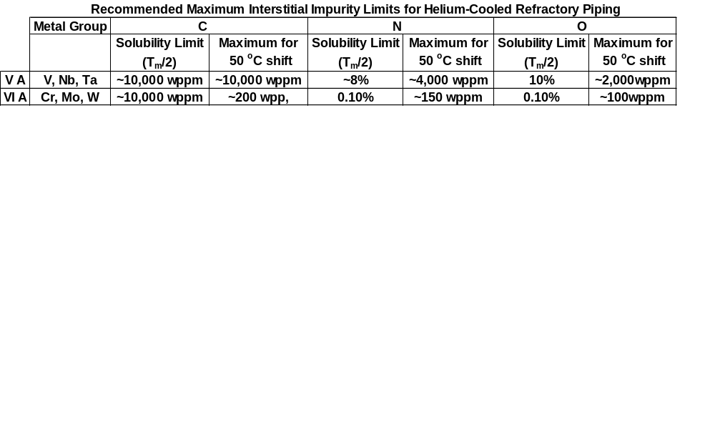
COMPATIBILITY OF REFRACTORY METALS WITH NON-METALLIC IMPURITIES (cont.)
Note that the most stringent control has to be on oxygen impurities at a level of less than 100wppm.

Slide 31
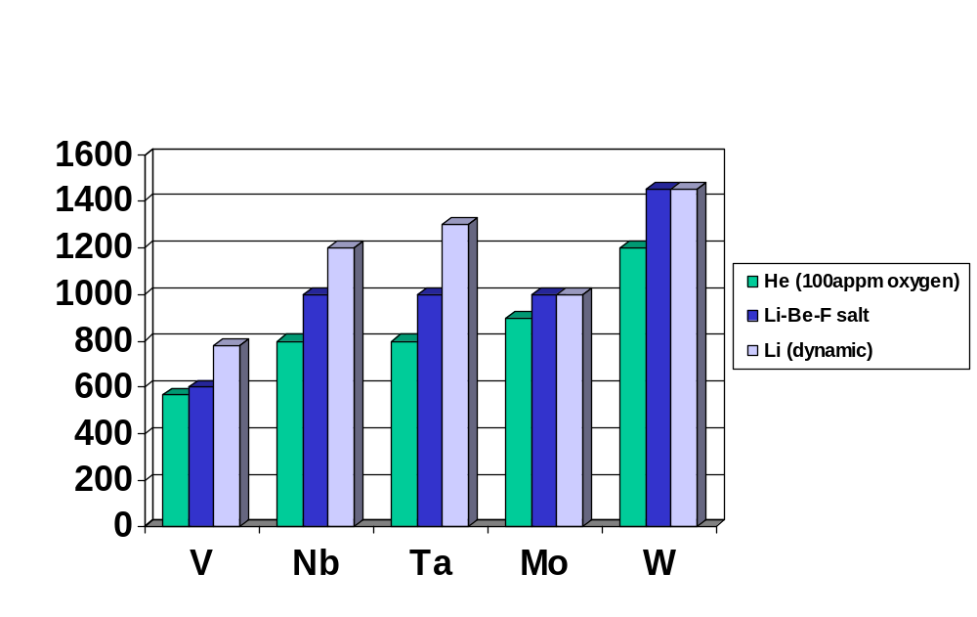
ESTIMATED UPPER TEMPERATURE LIMITS ON THE BASIS OF COMPATIBILITY
T (ºC)
T_{m} (K) 2175 2740 3287 2890 3680

